Slide 1
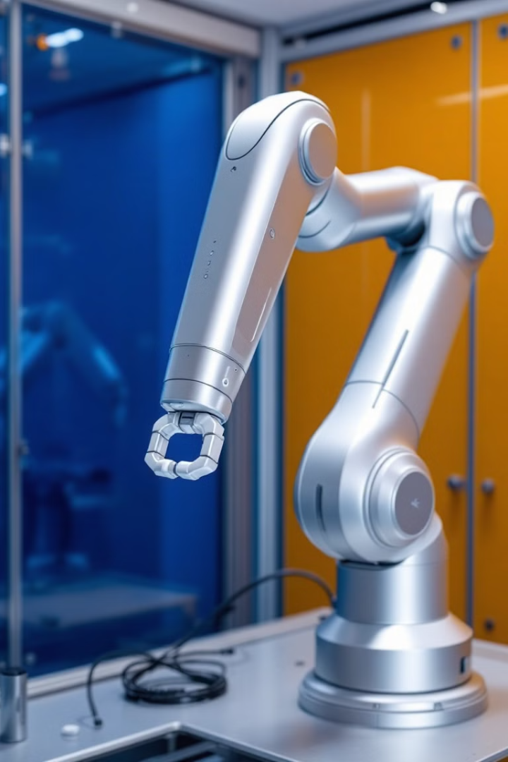
Design and Development of a 6-Degree-of-Freedom Robotic Arm for composite Fibre Placement
Chief Delaney Blessings Garikayi
Tendai Takuramunashe Gurupira
B.Tech Mechatronics Engineering, KIIT University
Supervisor: Dr. Nitin Sharma

Slide 2
Contents
Introduction
Literature Review
Project Objectives
Workflow
Inverse and Forward Kinemaatics Analysis in MATLAB Simulink
Development of Physical Prototype
Interfacing MATLAB-Adruino UNO
Conclusion
Challenges and Future Work
Errors Encountered
Reference

Slide 3
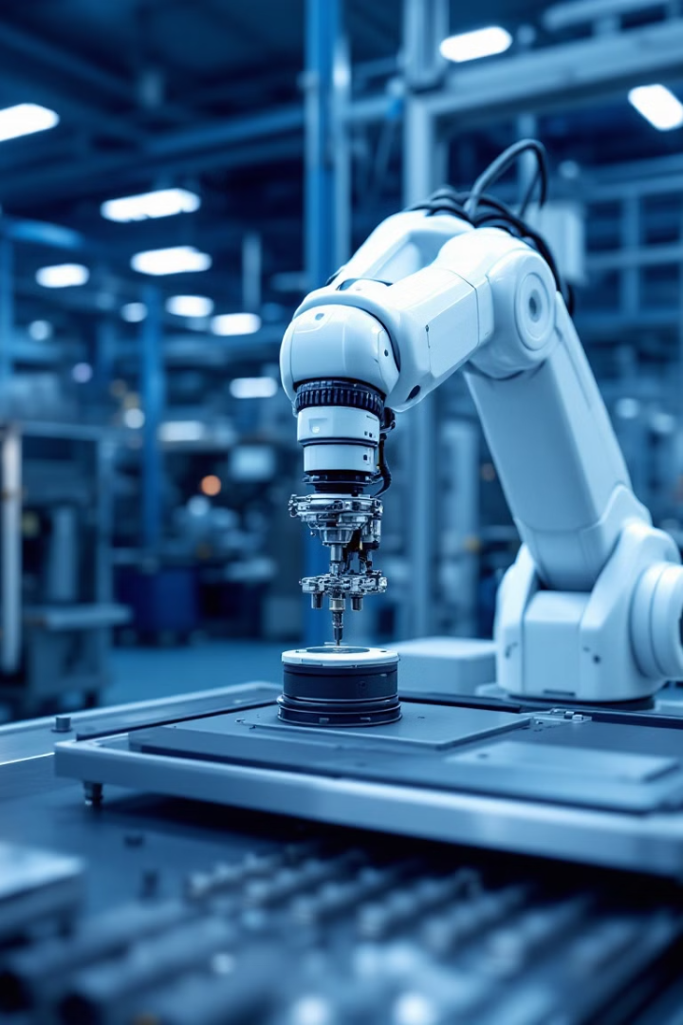
Introduction
Applications of a 6-DOF Robotic Arm
Manufacturing
Healthcare
Welding, painting, assembly.
Surgeries, rehabilitation.
Didactics
Teaching robotics, programming, engineering.

Slide 4
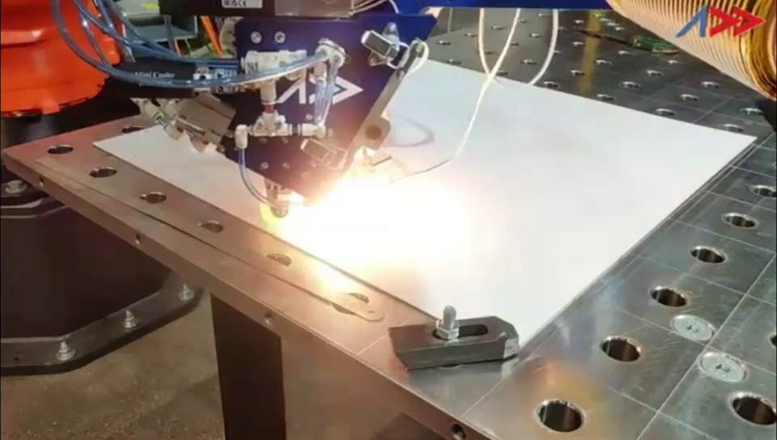
Contd…
A robotic arm being used for Automatic Fibre Lay-up.
The end effector can be modified to adapt the robotic arm for pick-and-place application.

Slide 5
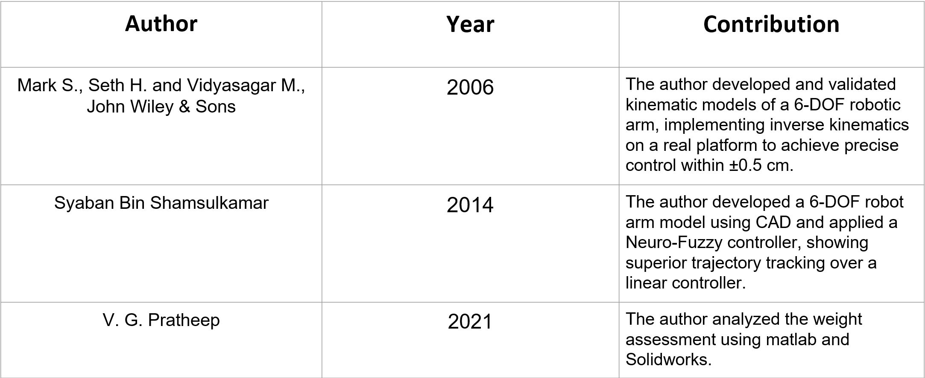
Literature Review

Slide 6

Objectives
Design of a 6-dof robotic arm and a CAD model in Solidworks
Inverse kinematic analysis in MATLAB Simulink for generating the motion of each joint for a specified trajectory
Development of a physical prototype and an Arduino based control circuit to impart motion signals to the motor connected to each joint
Data transfer from Simulink (angular values obtained from inverse kinematics) to physical protoype (Arduino) to realize the motion of the prototype

Slide 7
Workflow
Design the robotic arm/links/working envelop as per the application
Perform Inverse Kinematic Analysis
Develop CAD model in Solidworks/Simscape
Generate the angular movements for each joint
Generate the code in Simulink and transfer it to Arudino for controlling the motors in pyhsical prototype
Generate a rigid body tree using a Simulink extension in Solidworks
Pass the angular values to Forward Kinematics block to generate the output trajectory
Import the model and the rigid body tree in MATLAB Simulink
Compare the input and the output trajectory and add PID control to improve the output
Specify the input trajectory to be traced by the robotic arm

Slide 8
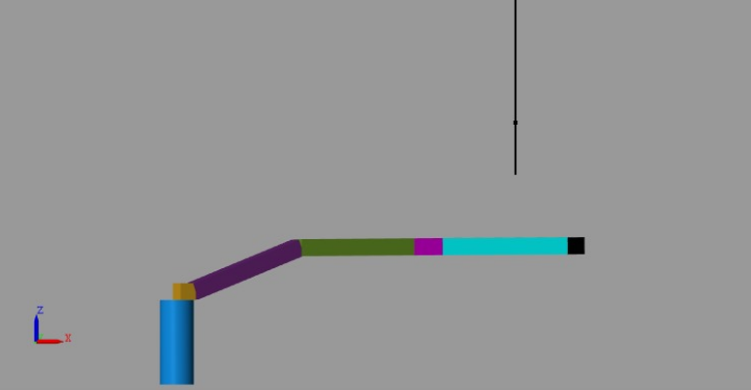
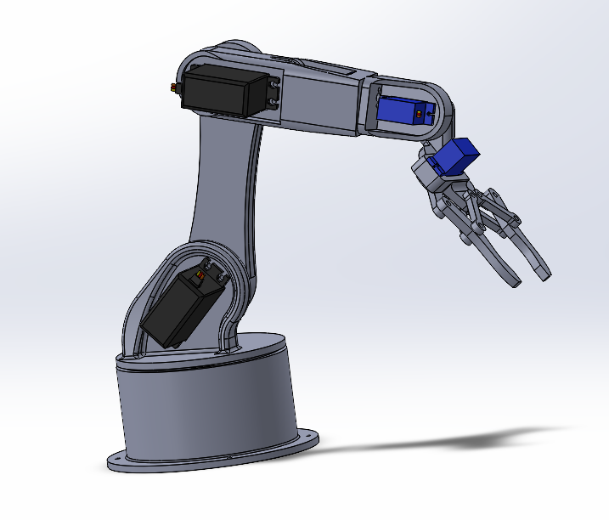
Inverse & Forward Kinematic Analysis in Matlab/Simulink
Models for Analysis
Model-I: Model developed in MATLAB Simscape -
A simplisitc represntation of links using basic geometrical shapes while preserving the joint configuration and dimensions.
The rigid body tree is generated in the MATLAB.
Relatively easy to control
2. Model-II: Model developed in Solidworks -
Actual model with the links having the desired geometry.
The model needs to be imported to Simulink using an extension

Slide 9
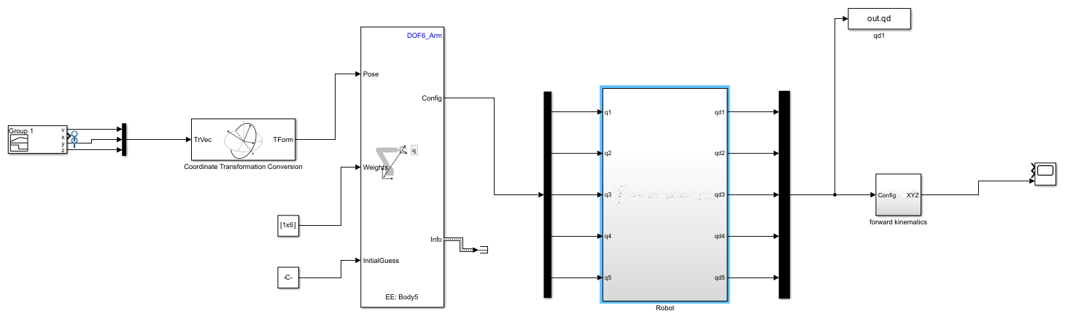
Inverse and Forward Kinematic Analysis in Matlab Simulink
Analysis Flow in MATLAB Simulink
Trajectory as an input to the inverse kinematic block
Generated angular values of each joint
Feeding angular values to robotic arm
Input trajectory
Coordinate Transformation
Path traversed by robotic arm
Forward Kinematics block
Inverse Kinematics block
Robot model
(rigid body tree)

Slide 10
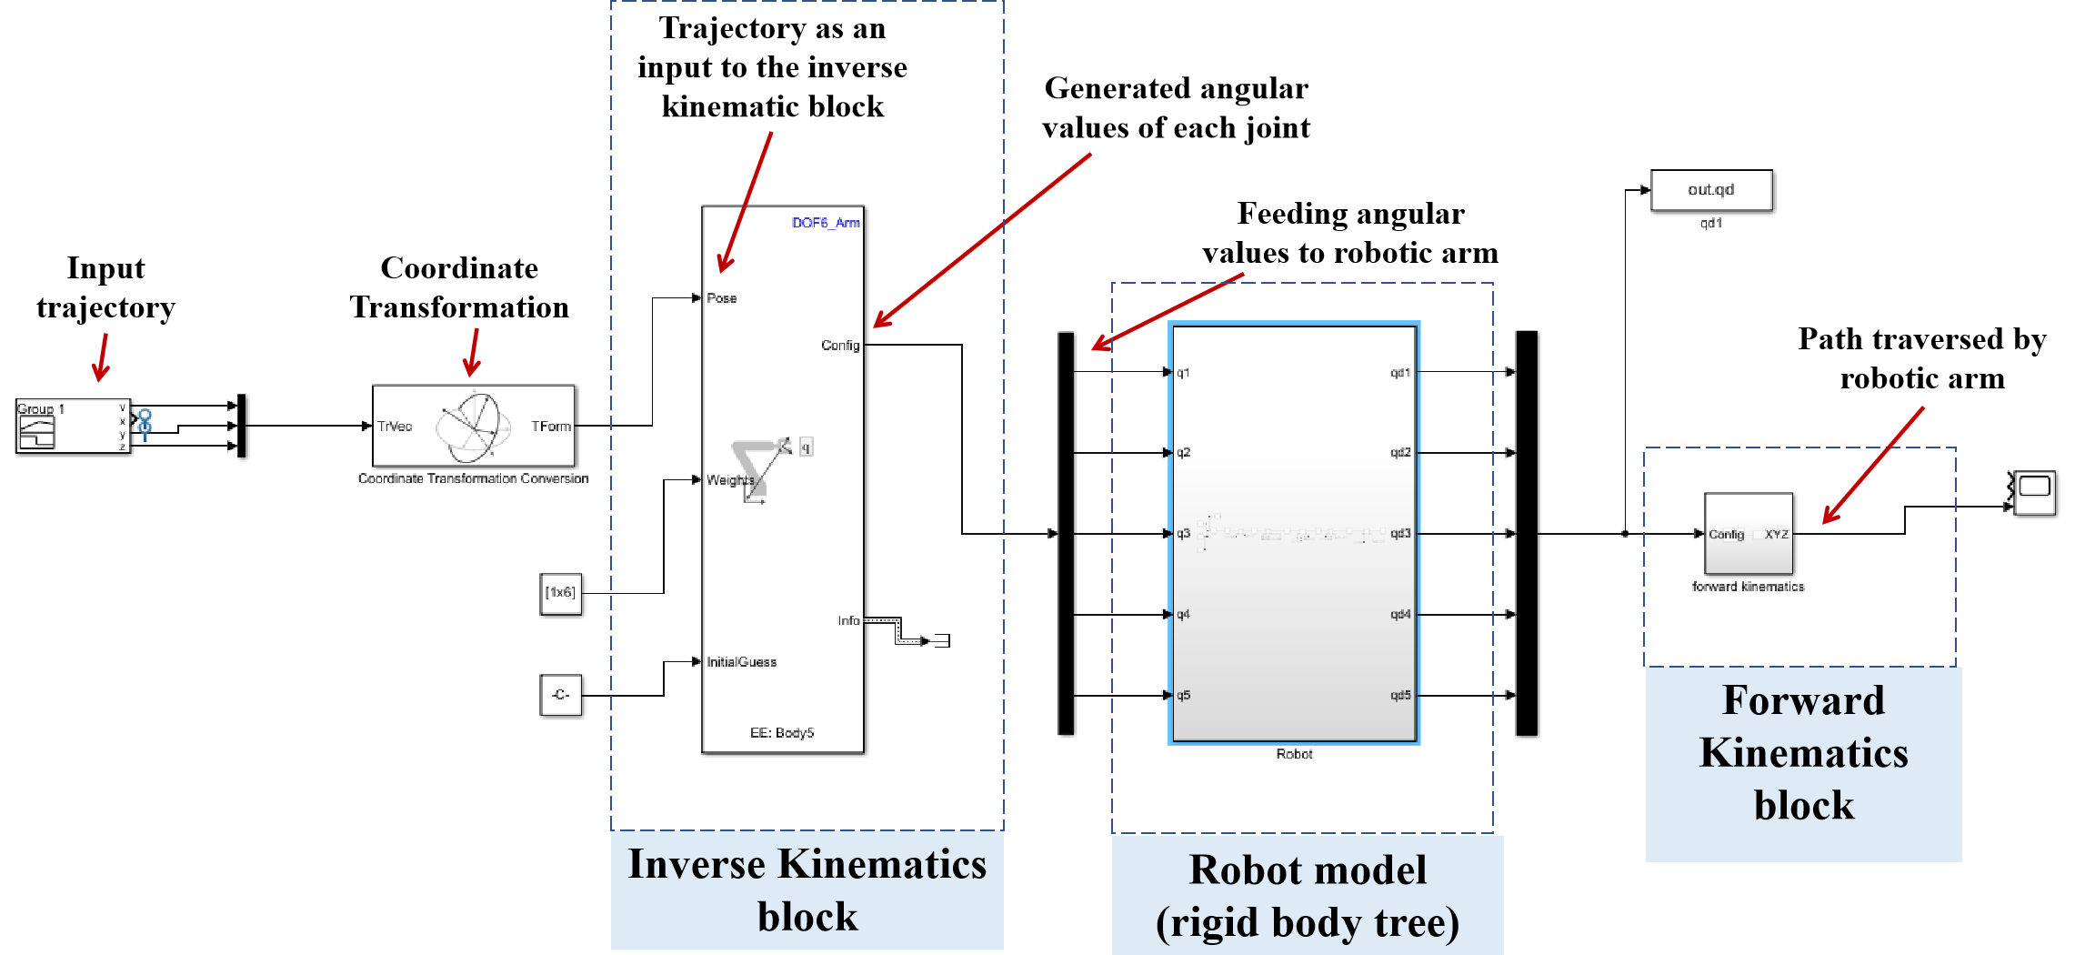
Inverse and Forward Kinematic Analysis in Matlab/Simulink
Analysis Flow in MATLAB Simulink
Interface MATLAB with Arduino
Upload code to Arduino for robot movement
Inverse and Forward Kinematics

Slide 11
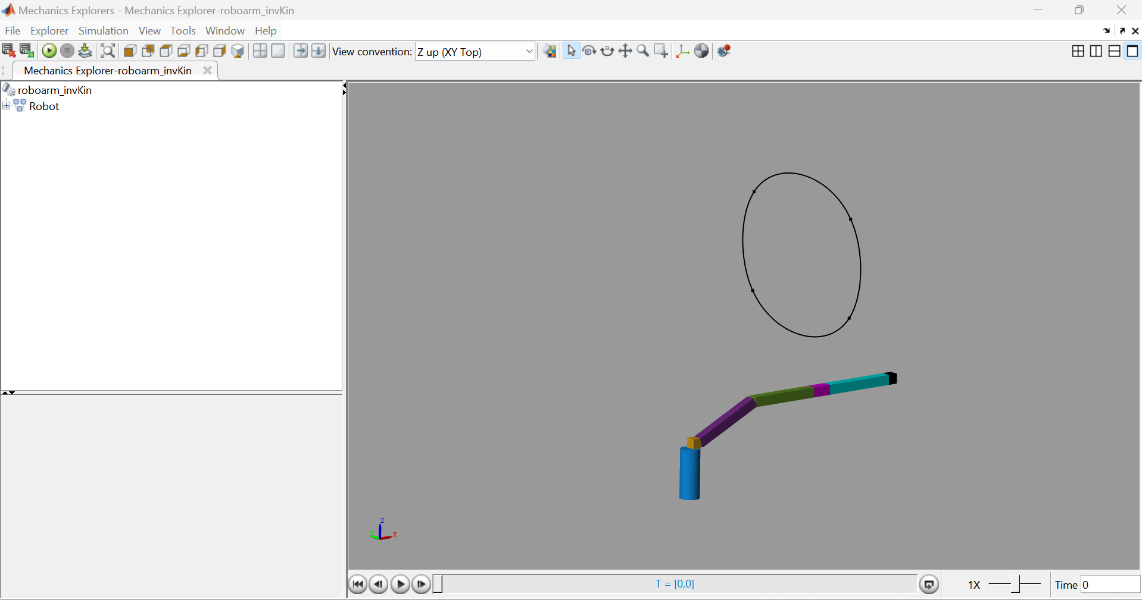
Model-I : Simscape Model - 5 DOF
Input Trajectory
Robotic Arm Model

Slide 12
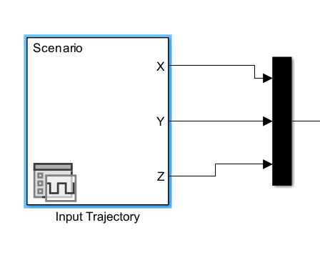
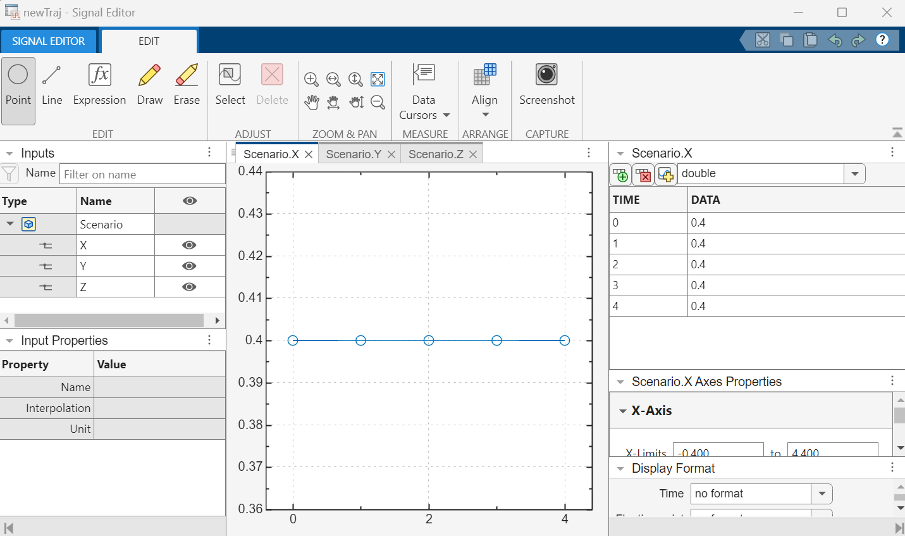
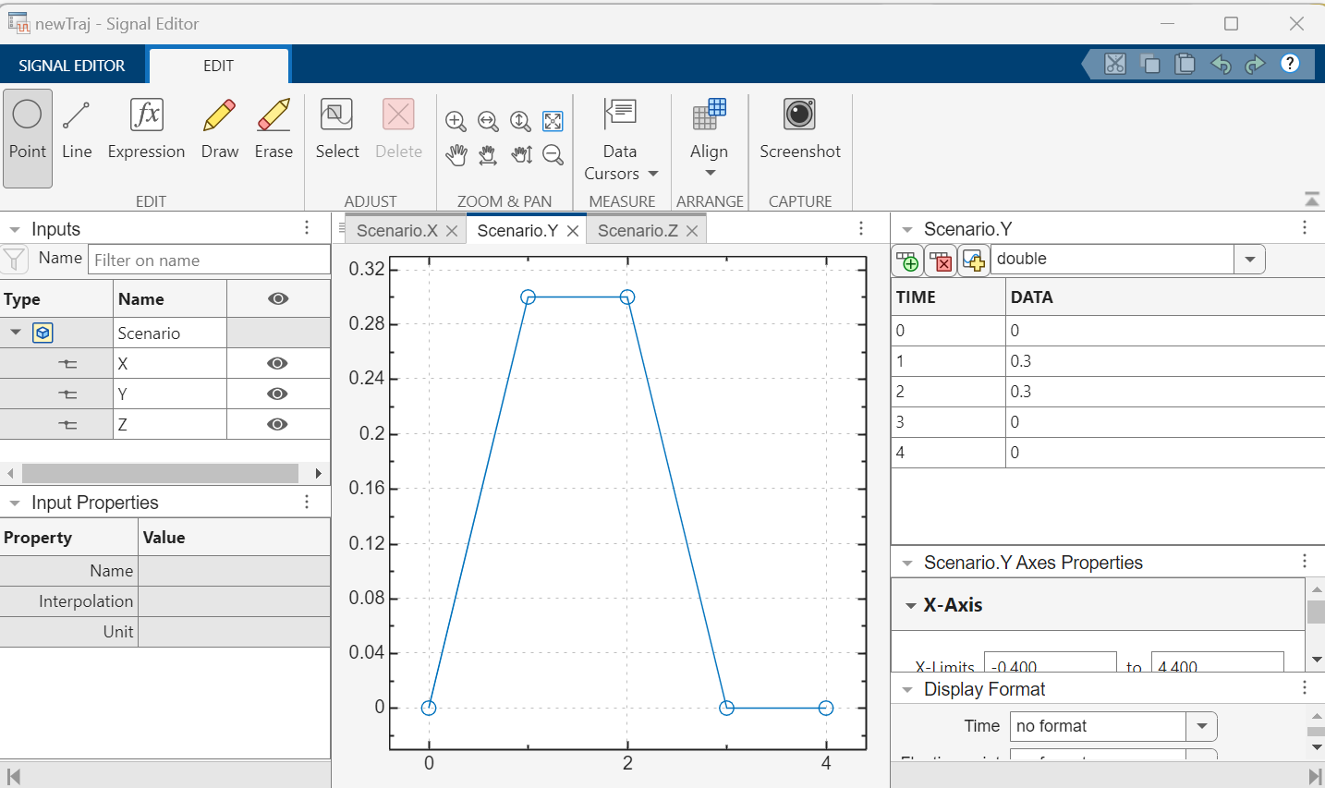
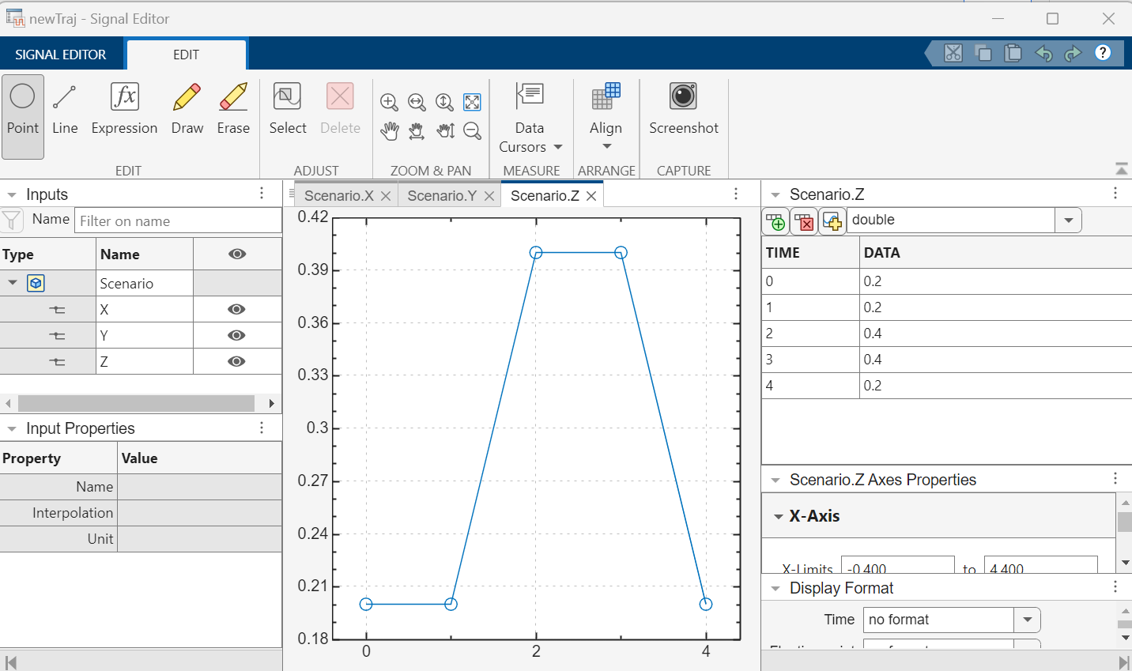
Model-I : Simscape Model - 5 DOF
Input Trajectory Block
Input Trajectory for Model-I
(0.4, 0, 0.4) C
B (0.4, 0.3, 0.4)
z
A --> B --> C --> D
O
y
x
(0.4, 0, 0.2) D
A (0.4, 0.3, 0.2)
Defining trajectory in the block
x-coordinates
y-coordinates
z-coordinates

Slide 13
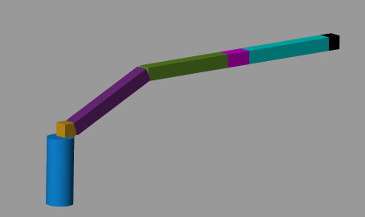
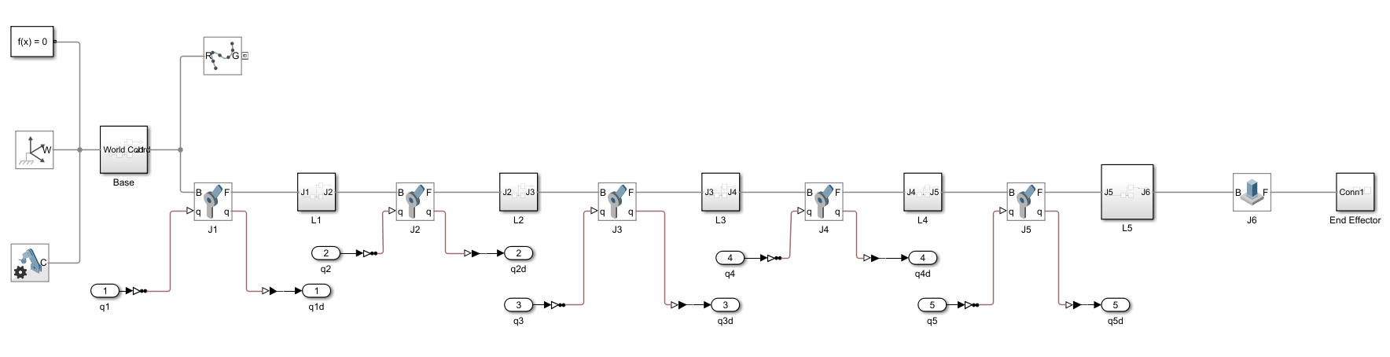
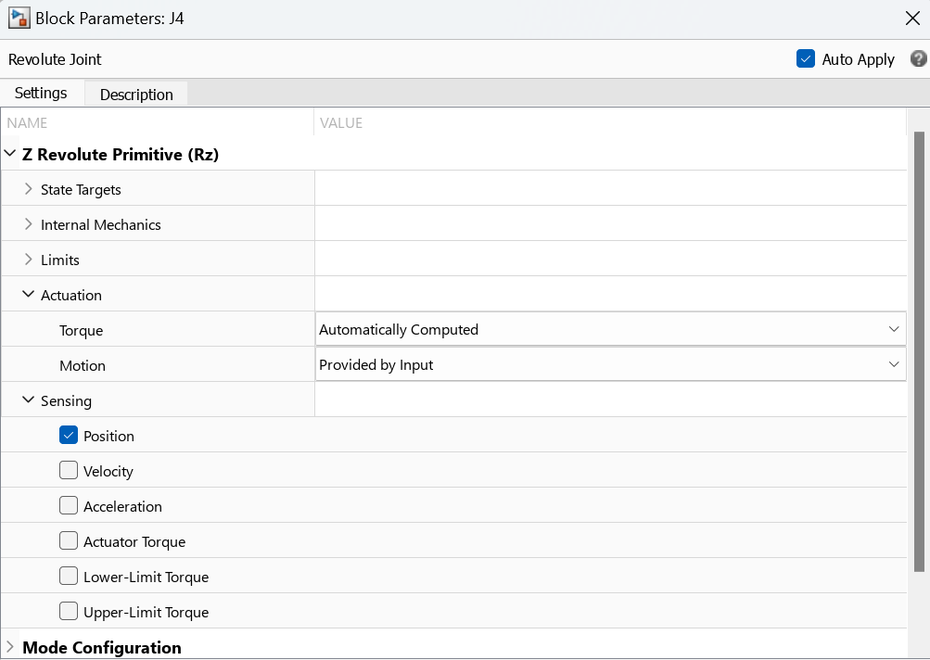
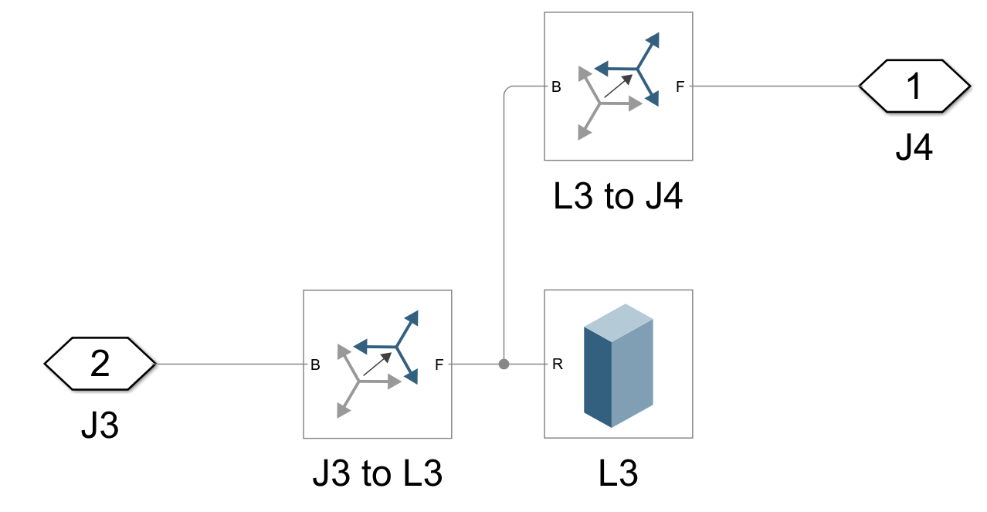
Inverse and Forward Kinematic Analysis in Matlab/Simulink
Rigid Body Tree from Simscape Model
Model-I
Joint configuration
Link connected with joints

Slide 14
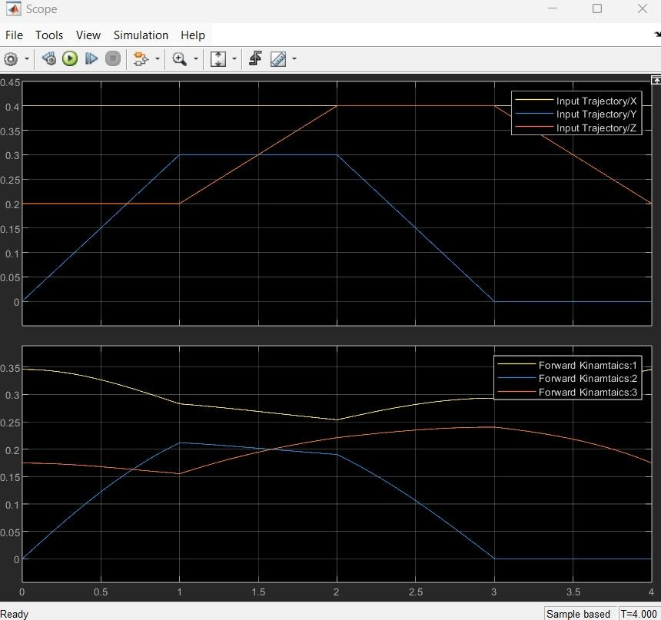
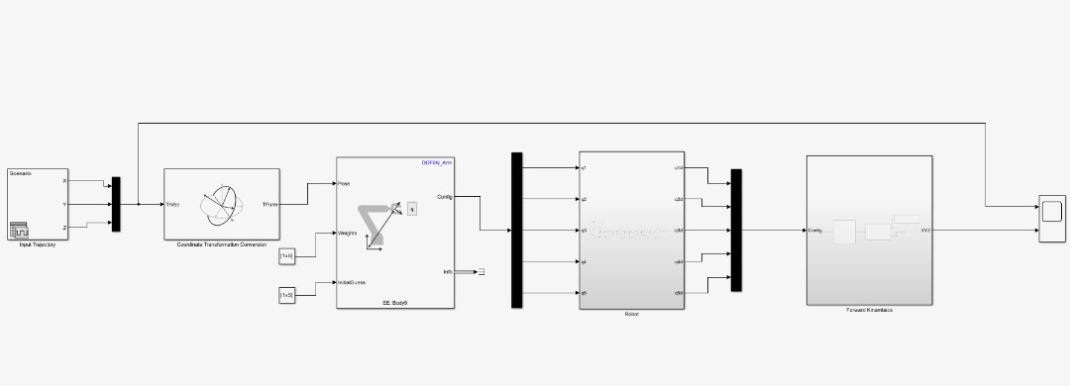
Inverse and Forward Kinematic Analysis in Matlab/Simulink
Model-I: Simscape Model without PID
Input and Output Trajectories
Input
Input
Input
Output
Output
Output

Slide 15
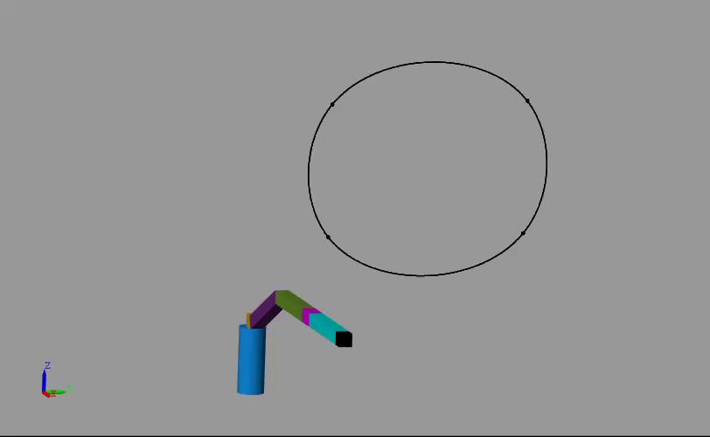
Inverse and Forward Kinematic Analysis in Matlab/Simulink
Model-I: Simscape Model without PID

Slide 16
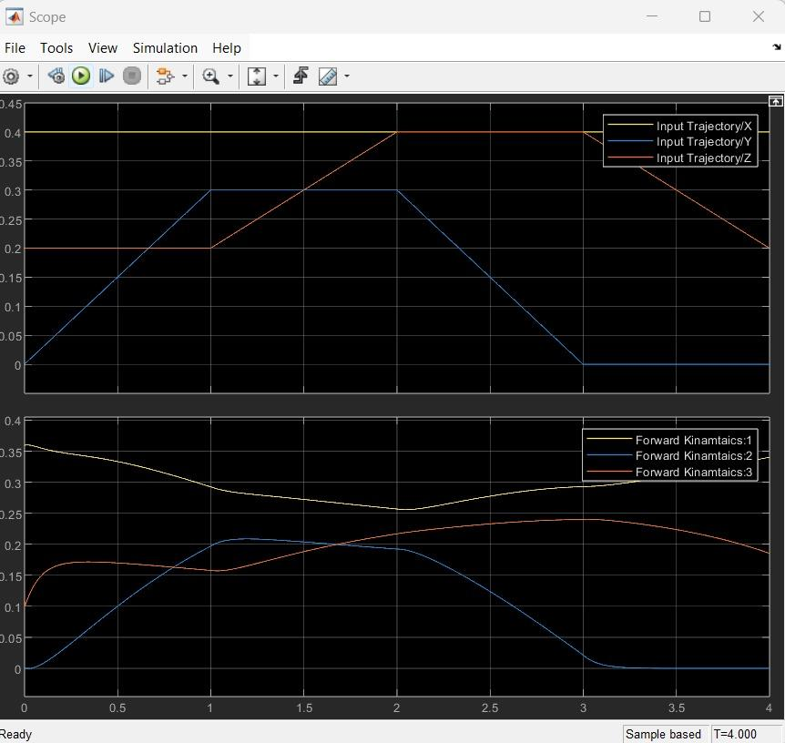
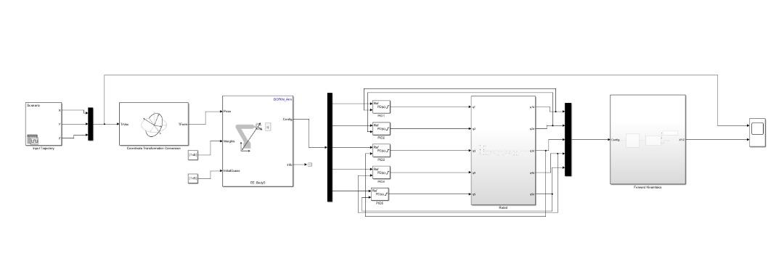
Inverse and Forward Kinematic Analysis in Matlab/Simulink
Model-I: Simscape Model with PID Control
Input and Output Trajectories
Input
Input
Output
Output

Slide 17
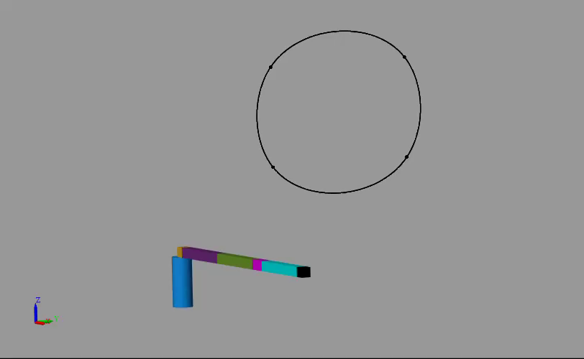
Inverse and Forward Kinematic Analysis in Matlab/Simulink
Model-I: Simscape Model with PID Control

Slide 18
Model-II : Model in Solidworks
3 (Rot-y)
Link 3
(Upper arm)
Link 2 (Wrist)
The CAD model was done with the help of Solidworks software.
Each part of the robotic arm was designed separately and assembled together.
z
y
x
5 (Rot-y)
robot arm base
4
(Rot-x)
Link 4
(Lower Arm)
Link 1
(End Effector)
Link 5
(Shoulder)
2 (Rot-y)
6 (Rot-z)
opening and closing
1 (Rot-z)
Link 5
(Base)
DOF = [1, 2, 3, 4, 5, 6)
Workspace 360mm

Slide 19
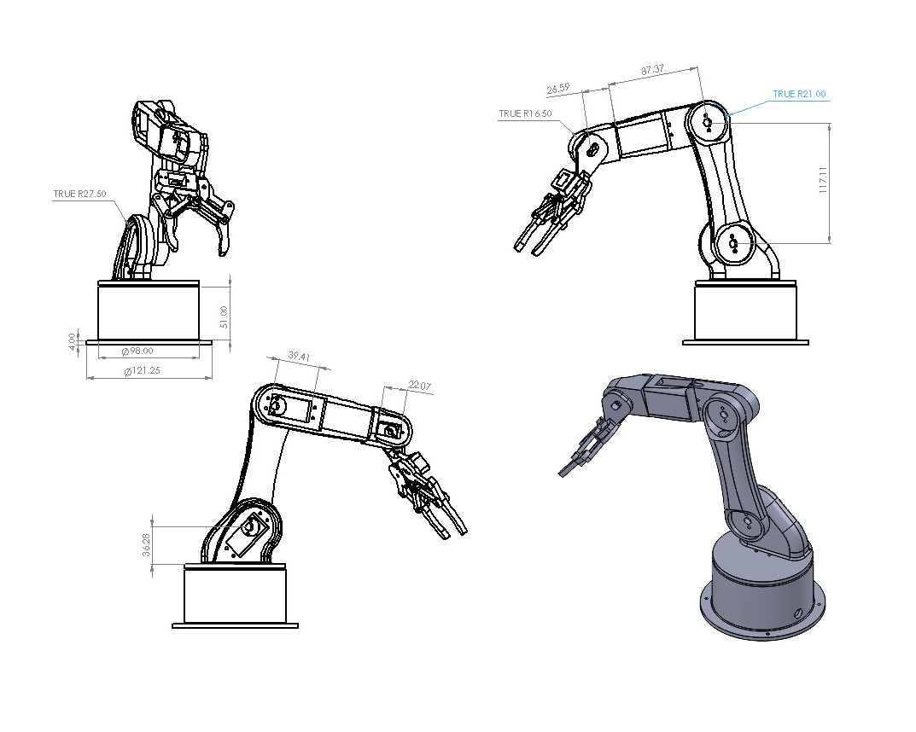
Model-II : Dimensions and Views
Front view
Right view
All dimensions in mm

Slide 20
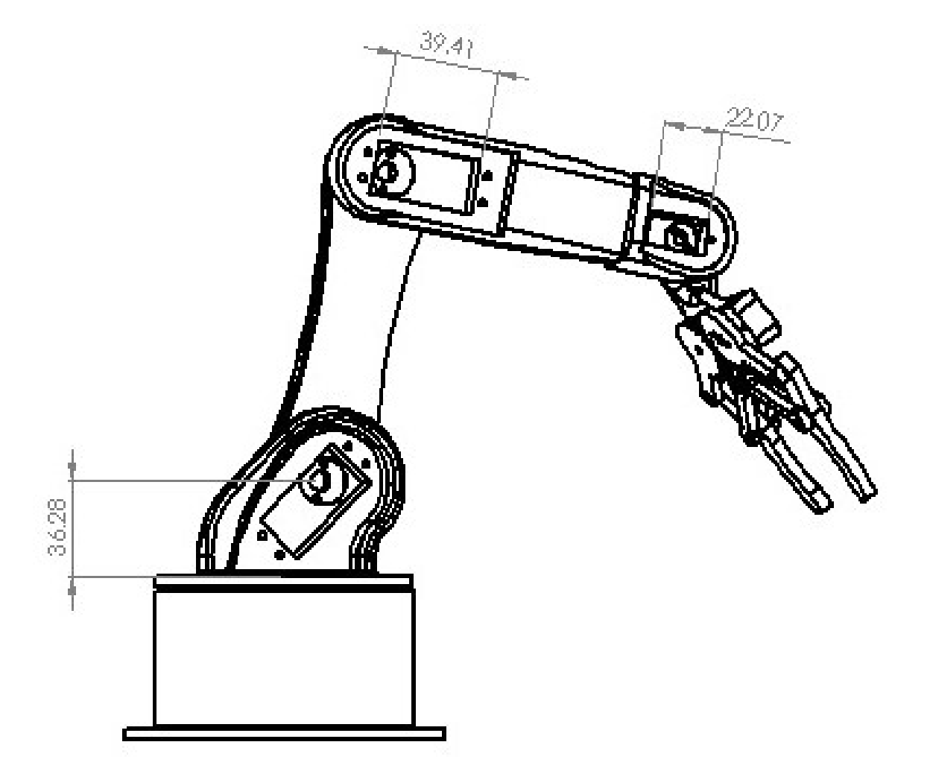
Model-II : Dimensions and Views
Left view
Isometric Model view
All dimensions in mm

Slide 21
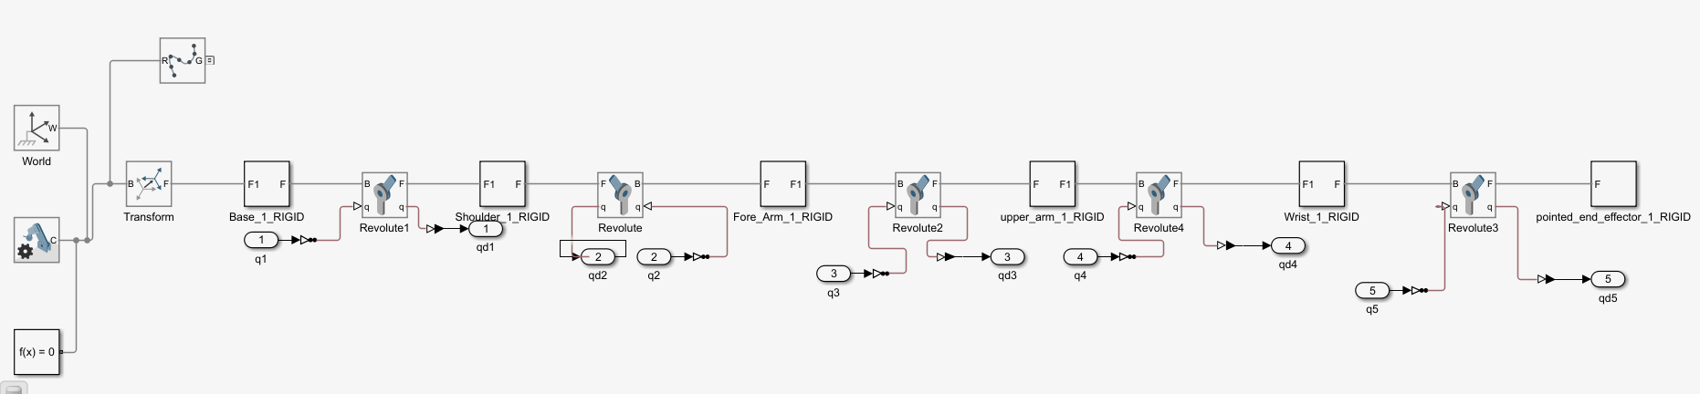
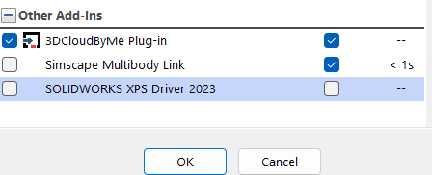
Inverse and Forwad Kinematic Analysis in Matlab Simulink
Rigid Body Tree from the CAD Model
Model-II
Generated using in Silidworks using an extension for Simulink
The extension converts the CAD model to a rigid body tree that can be used directly in simulink for simulation

Slide 22
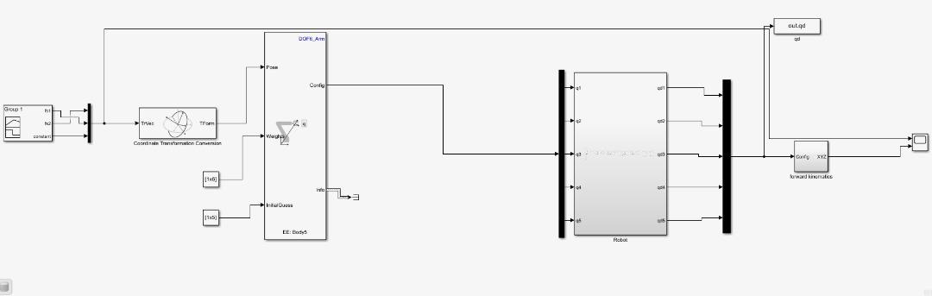
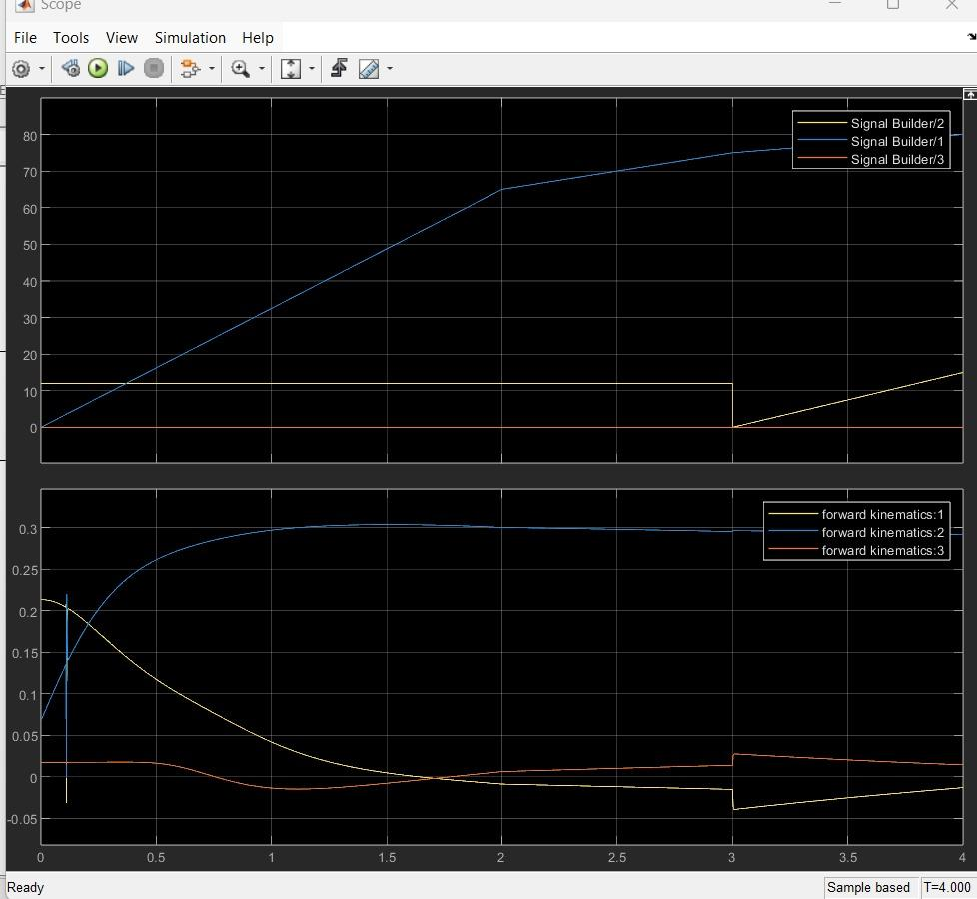
Inverse and Forward Kinematic Analysis in Matlab/Simulink
Model-II: Control without PID
Input and Output Trajectories
Input
Input
Output
Output

Slide 23
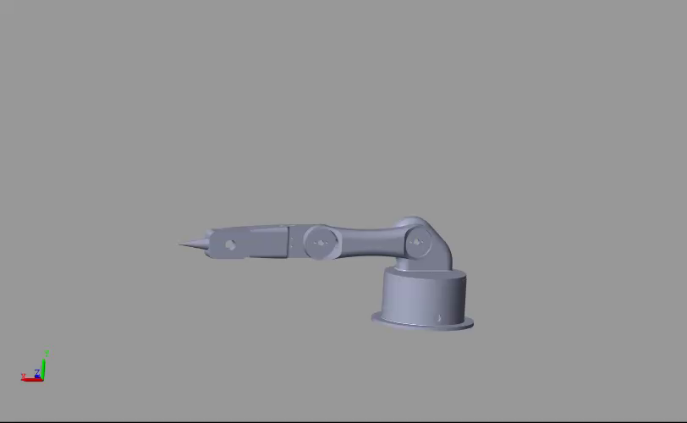
Inverse and Forward Kinematic Analysis in Matlab/Simulink
Model-II: Control without PID

Slide 24
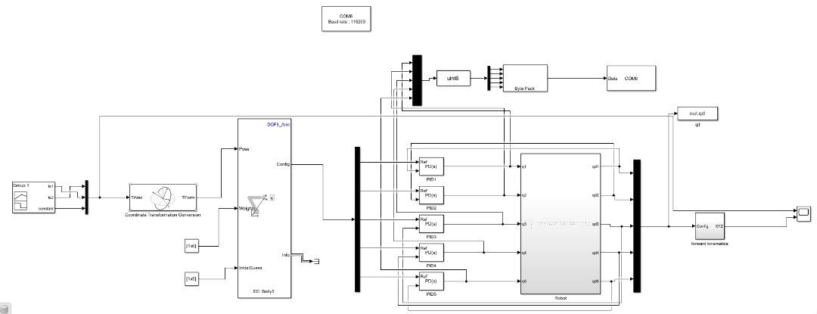
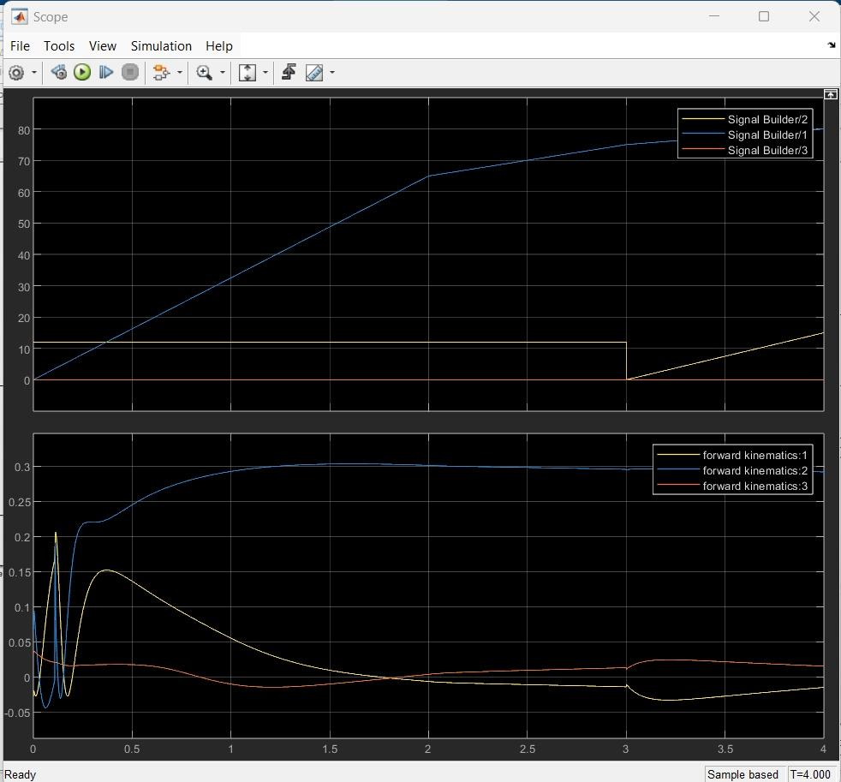
Inverse and Forward Kinematic Analysis in Matlab/Simulink
Model-II: Control with PID
Input and Output Trajectories
Input
Input
Output
Output

Slide 25
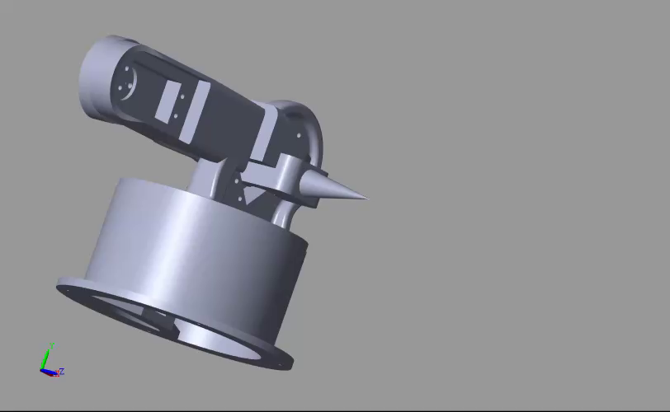
Inverse and Forward Kinematic Analysis in Matlab/Simulink
Model-II: Control with PID

Slide 26
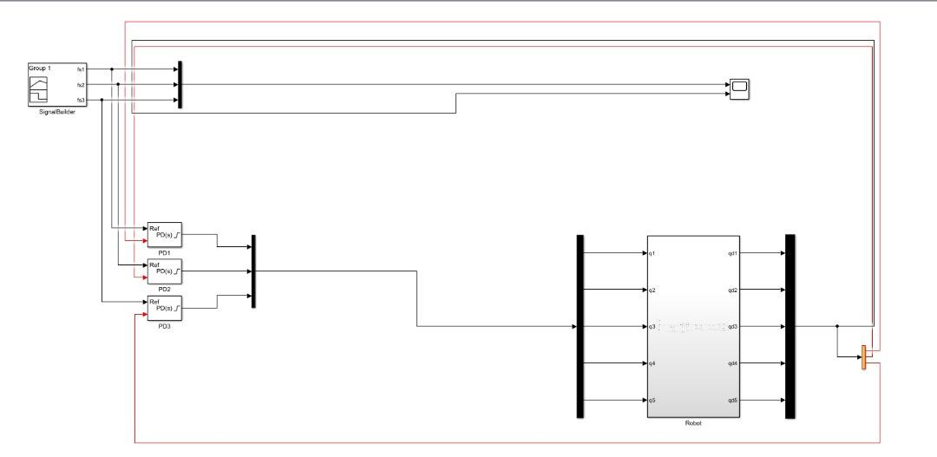
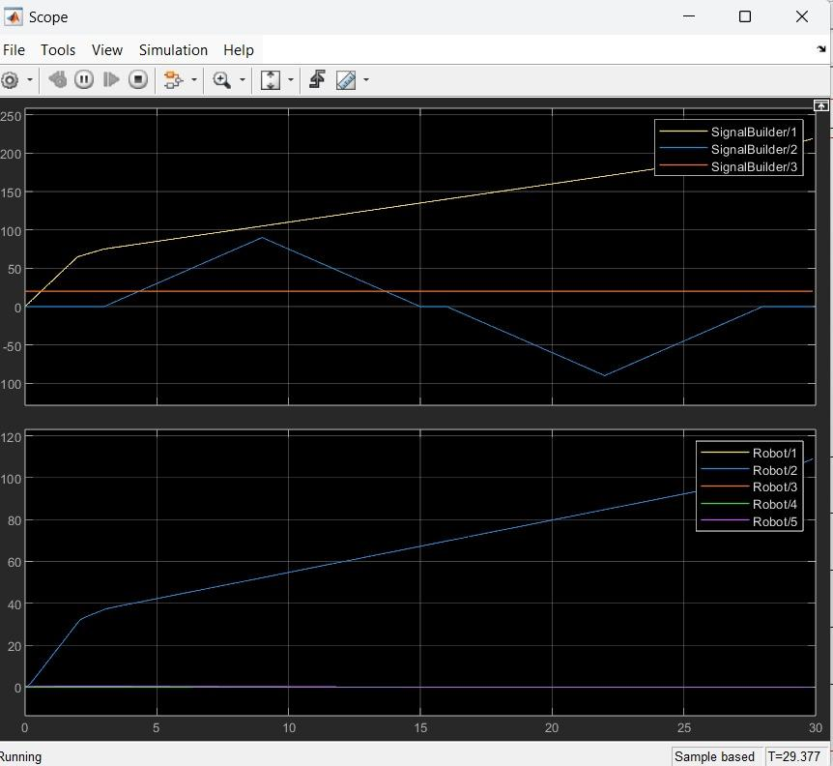
Inverse and Forward Kinematic Analysis in Matlab/Simulink
Model-II: Control without Inverse Kinematics and Forward Kinematics with PID
Input and Output Trajectories
Input
Input
Output
Output

Slide 27
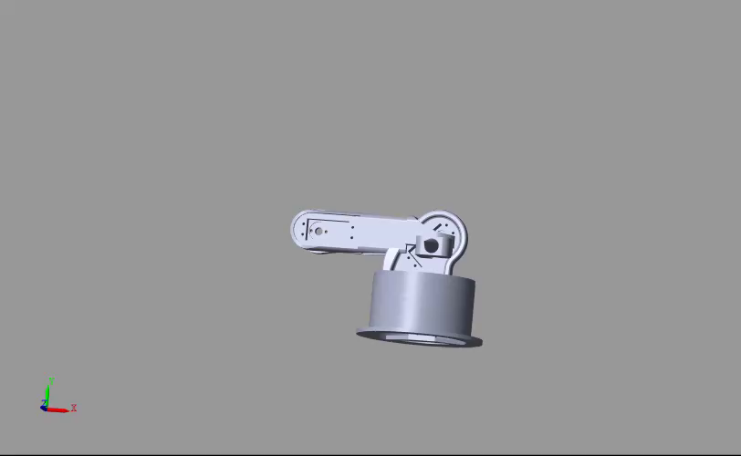
Inverse and Forward Kinematic Analysis in Matlab/Simulink
Model-II: Control without Inverse Kinematics and Forward Kinematics with PID

Slide 28
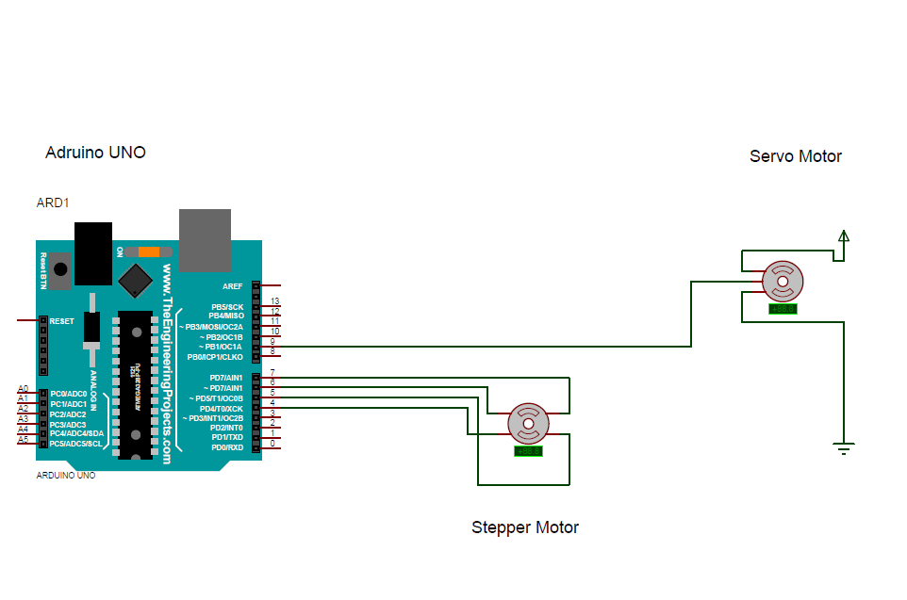
Development of Physical Prototype
Components
Circuit Design
Actuators
Motors that drive the movement of the robotic arm
Control Hardware
The computer system that controls the robot's movements. It processes input from sensors and commands the actuators. E.g. Arduino Uno
End-Effector
It interacts with objects. In a pick-and-place robot, this is often a gripper or vacuum suction device.
Joints and Links
Joints provide the degrees of freedom for the arm's movement, while links are the segments between joints.
Battery Power Source
Provides the necessary electrical power for the actuators and control systems.
Manipulator Arm
The main structure of the robotic arm, which holds the joints, links, and end effector.
Cable Connection
These include the wiring and connectors needed to power the actuators, connect sensors, and link the controller to other components.

Slide 29
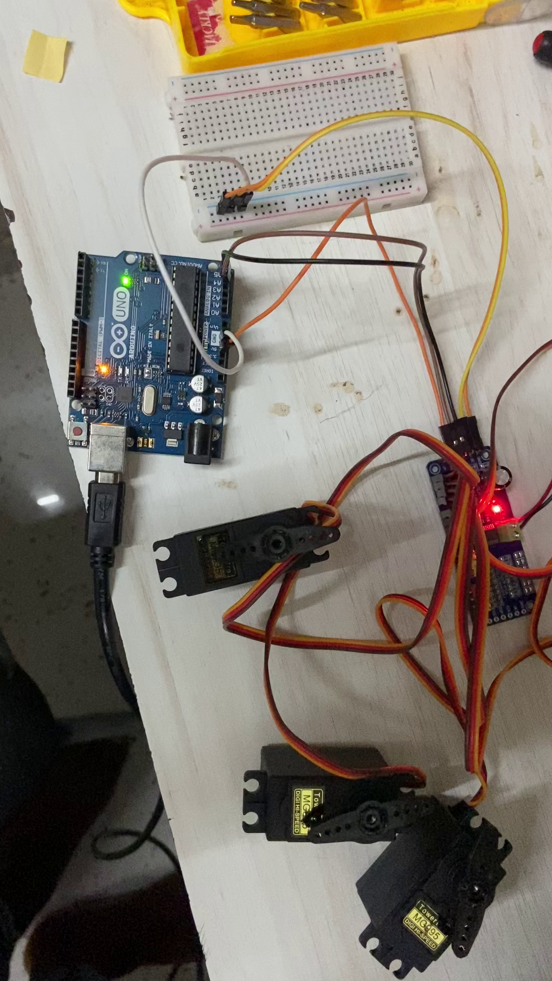
Development of Physical Prototype
Circuit Implementation
Implementation of the circuit, using Arduino and PCA9685 motor driver
The driver amplifies signals from the microcontroller to drive the motors effectively to achieve smooth operation

Slide 30
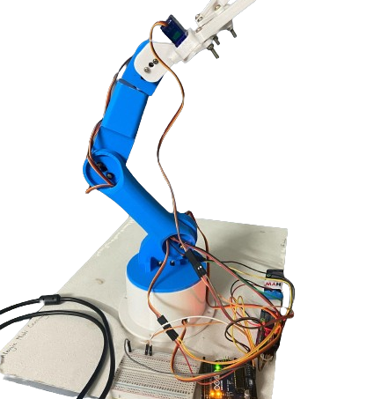
Development of Physical Prototype
Physical Model
B.Tech Mechatronics Engineering, KIIT University

Slide 31
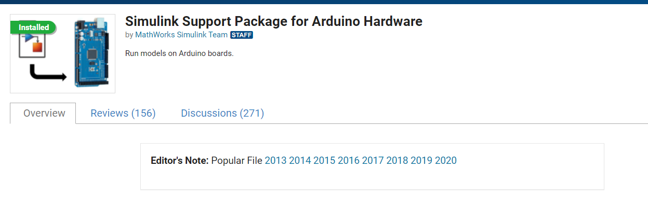
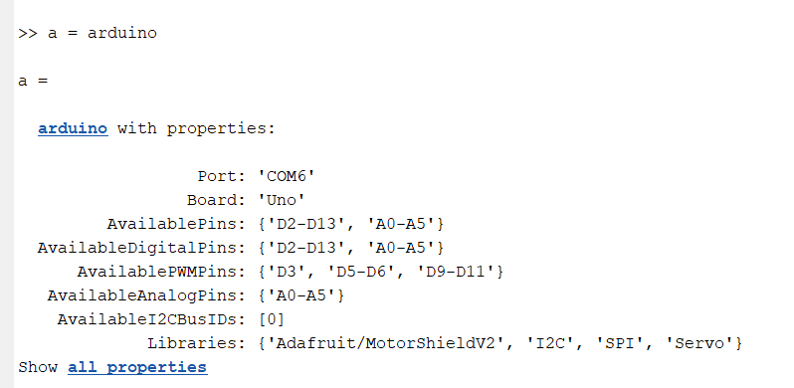
Interfacing MATLAB-Arduino UNO

Slide 32
Conclusion
A 6-dof robotic arm was developed for automatic fibre placement application
Two models were developed and simulated using the Robotics System Toolbox in MATLAB
Better control was obtained in Model-I as the rigid body tree was developed in Simscape itself
Model-II is the actual representation of the physical prototype but requires more tuning in order to have performed better output
The PID controller was integrated in the simulation. However, it requires more tuning in order for the output to be better matched with the input
A physical prototype was developed and interfaced with Arduino microcontroller sending inputs to 5 servo motors (one each for every dof)

Slide 33
Challenges and Future Work
Integration of gripper in simulation
Alternate control strategies to minimize the differences between the input and output trajectories
Better tuning of PID controllers
Implementaiton of PID controller in physical prototype
Interfacing MATLAB-Arduino

Slide 34
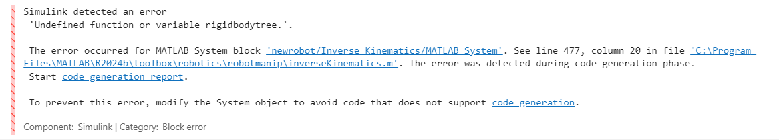
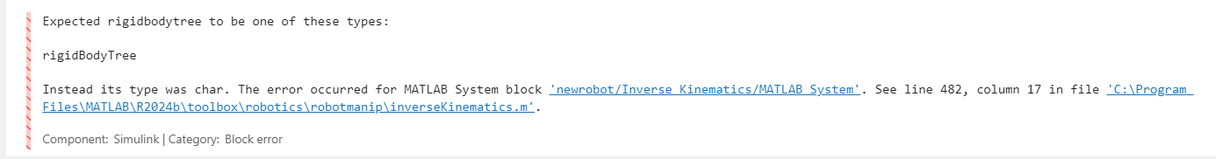
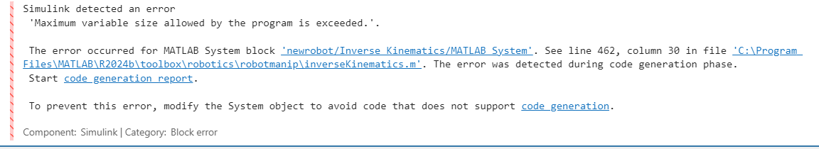
Errors Encountered

Slide 35
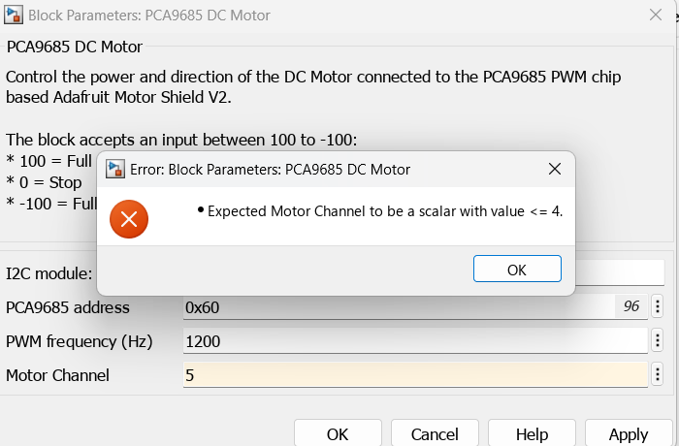
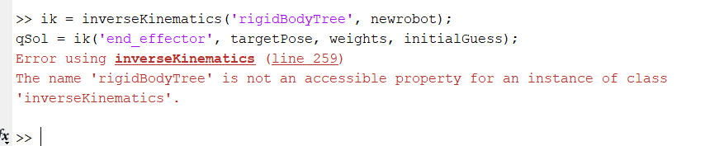
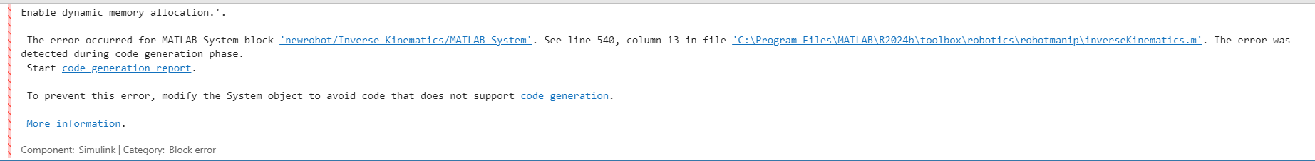
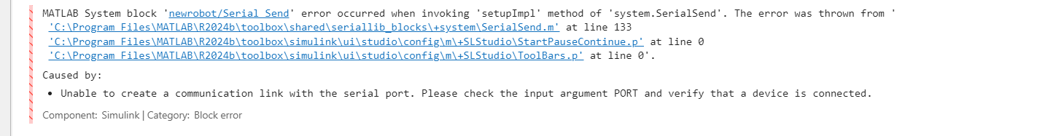
Errors Encountered

Slide 36
References
Hodges, D. H., & Reddy, J. N. (2003).
Mark S., Seth H. and Vidyasagar M., John Wiley & Sons(2006)
Syaban Bin Shamsulkamar(2014)
Chen, Y., et al. (2020).
V. G. Pratheep (2021).

Slide 37
THANK YOU

Slide 38
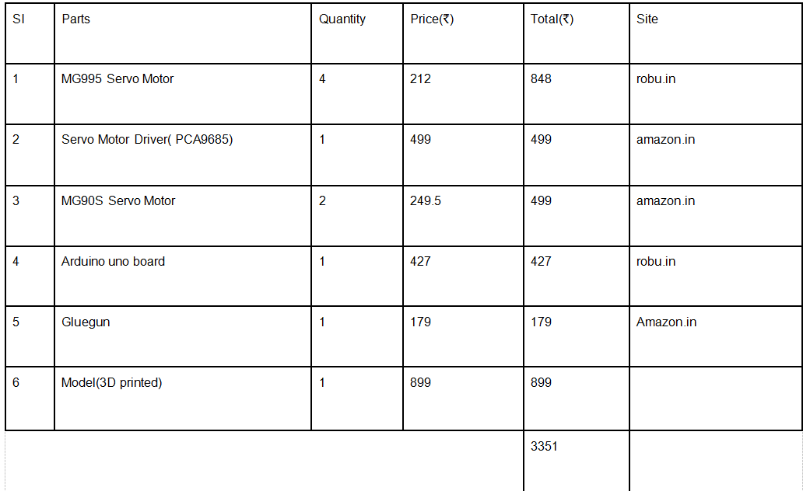
Cost Analysis

Slide 39

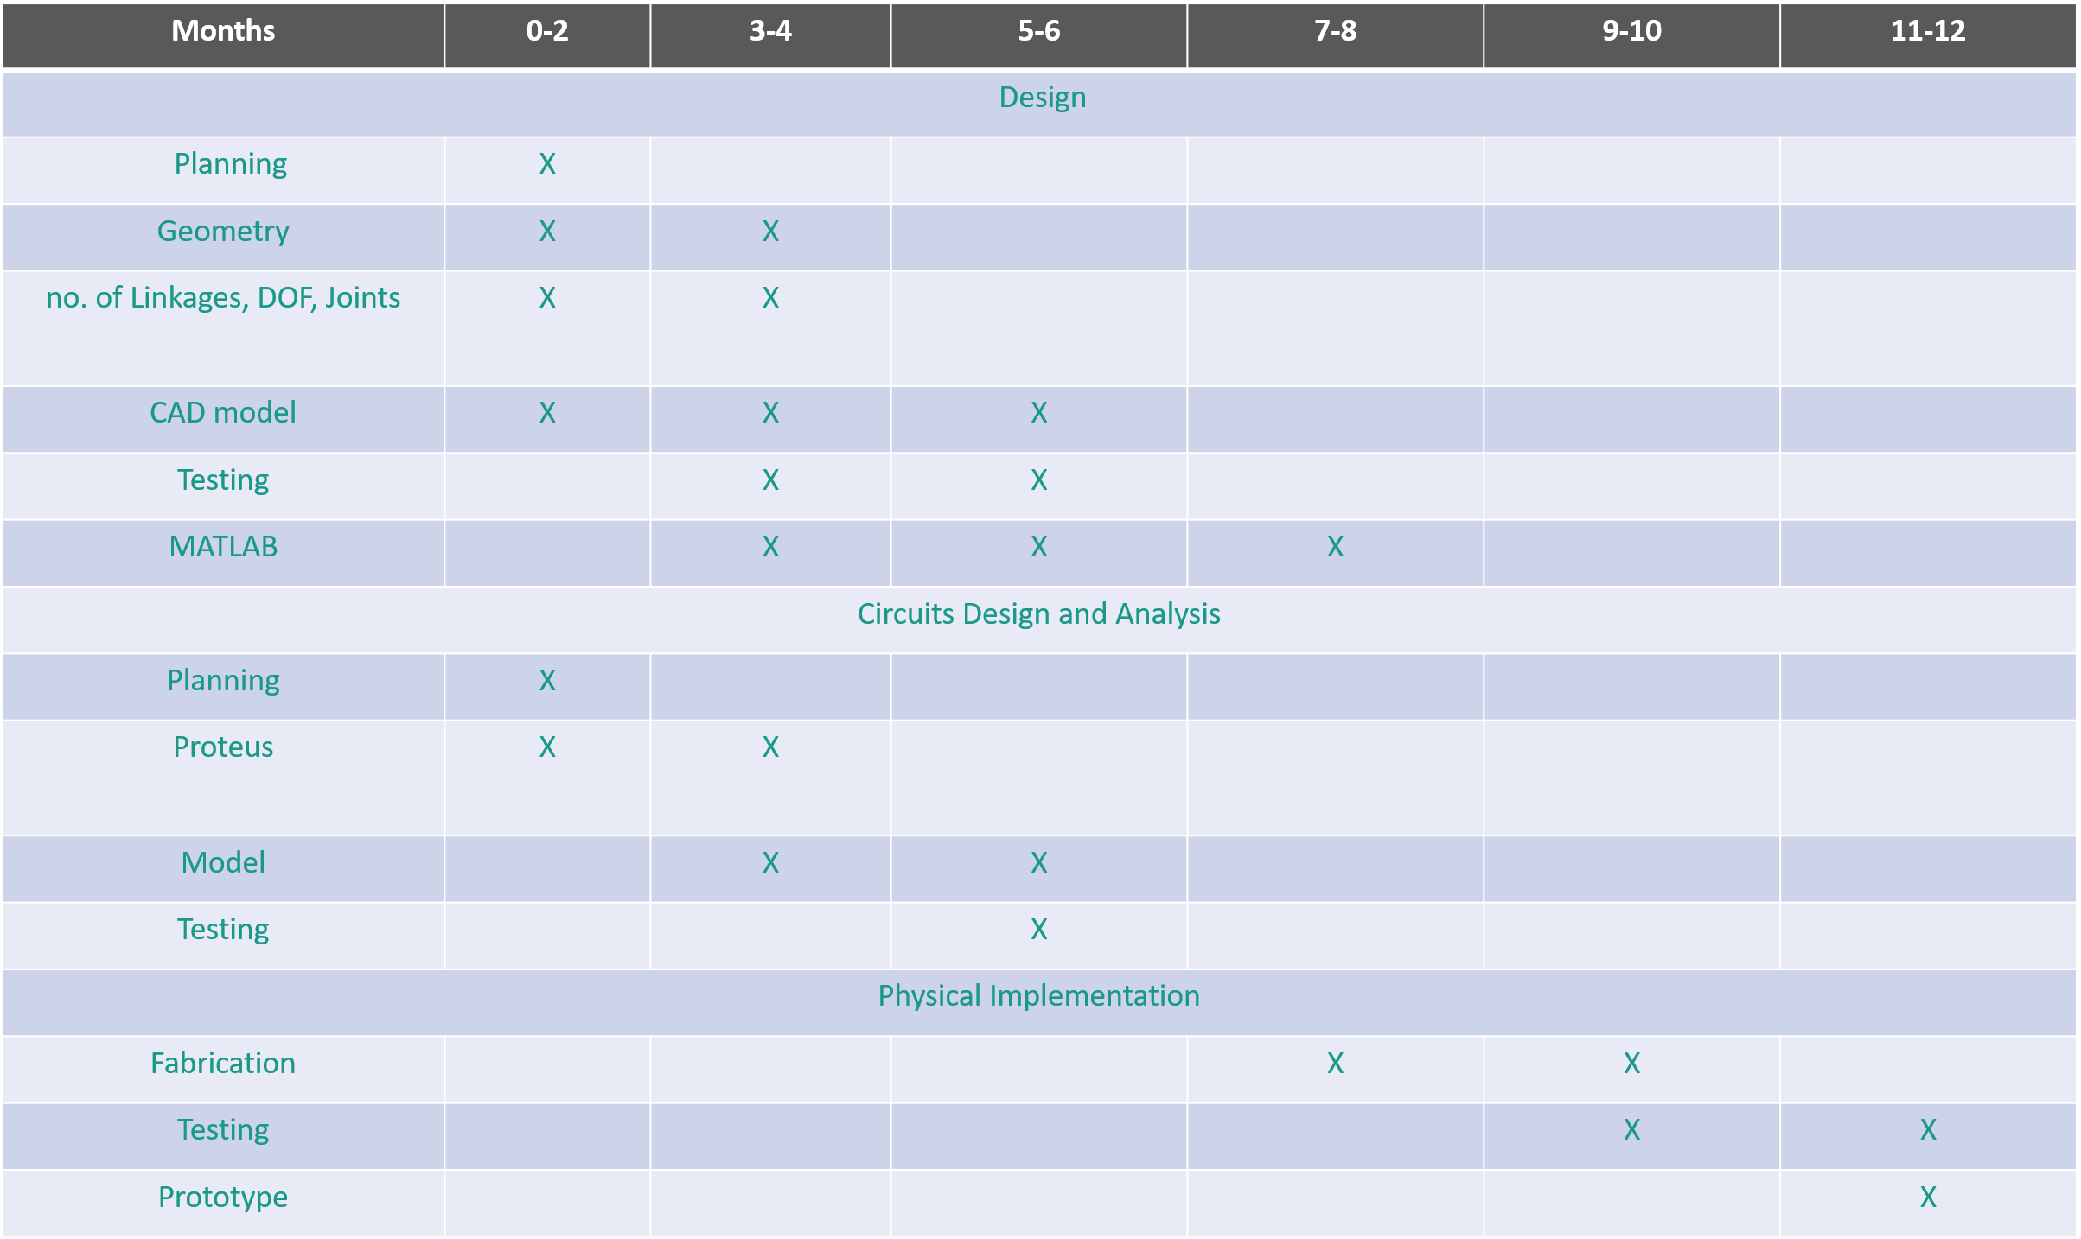
Project Timeline

